Slide 1

Into the Abyss: Evaluating Active Directory SMB Shares on Scale
SCOTT SUTHERLAND / SENIOR DIRECTOR, NETSPI

Slide 2


Scott Sutherland
Whoami
Senior Director, NetSPI
Adversary Simulation &
Infrastructure Testing
Twitter
@_nullbind
Blogs
https://blog.netspi.com/author/scott-sutherland/
Decks
http://slideshare.net/nullbind
Code
https://github.com/NetSPI/PowerUpSQL
https://github.com/NetSPI/SQLC2
https://github.com/NetSPI/ESC https://github.com/NetSPI/PowerHunt
https://github.com/NetSPI/PowerHuntShares

Slide 3
Agenda
1
What’s the Problem?
Why should I care about share access?
2
Share Permissions Primer How do they work and where do things go wrong?
3
What’s the Impact?
Exploiting SMB share access!
4
Share Remediation
How can we streamline share inventory and remediation?
5
PowerHuntShares
Let’s automate some things!

Slide 4
Into the Abyss: Evaluating Active Directory SMB Shares on Scale
Story Time.
Legacy of Shares
Notes:
It’s all going to the cloud, but all the way there yet.
Before cloud we had on premise, and we still do.
Like mainframes, SMB share usage may fade, but it likely wont completely disappear in the next 5-10 years.
Today we’re going to talk about the legacy of SMB shares left behind by the last generation of IT professionals.

Slide 5

Notes:
Once upon a time, there was a happy small business owner named Jane.
Jane worked alone and didn’t have to share files.

Slide 6


Notes:
One day, business picked up and Jane had to hire her first employee.
Now Jane had someone she needed to share files with. She shared files via email, and it was fine.

Slide 7


Notes:
As time went on, another person was hired and Jane had to share files with two people via email, which still worked… fine.
But, the tech savvy new guy, thought it was chaos. So, he created a fancy network share on his system so everyone could be more organized.
.and Jane was happy.

Slide 8

Notes:
Time marched on that another network share enthusiast was hired.
Eventually even Jane herself created a network share on her system, based on instructions she Googled.
After the novelty had worn off, which she promptly forgot about it.

Slide 9




Notes:
Finally, a new IT manager was hired to support the growing pool of employees, and they setup Active Directory and a file server.
Now they can support the centralized management of files and access control.
… except they forgot about all those shares that people created locally. ;)

Slide 10


Notes:
Then he added those shared to the gold image.

Slide 11

Notes:
Next, new 3rd party software was installed that needs network shares on a subset of systems share database backups.

Slide 12
Notes:
Devops started sharing things without checking with anyone to test out some ideas.

Slide 13

Notes:
Then one day her favorite employee leaves to pursue other opportunities, but Jane doesn’t decommission his systems, because there may be important files still being hosted there.
Now that system doesn’t have a formal owner.
At this point some of the shares maybe locked down, but more than you think are likely configured in a way that allows all employees access to them.

Slide 14


Notes:
So, this could be the actual exposure in Jane’s organization to an attacker with authenticated access to their environment.

Slide 15



Notes:
So…
A few months later when an employee clicks a malicious link in a phishing email, and they accidently run malicious code that gives an attacker their access.
They have access to all of those share without restrictions.

Slide 16

Notes:
Threat actors will use that access to do things like steel your data for resell or extortion.

Slide 17
Notes:
And perform ransomware attacks to extort even more money.

Slide 18
Notes:
They paid the ransom, managed to stay in business and then fixed the shares of the systems that were encrypted.
They thought they were done.

Slide 19
Notes:
But then devops opened another misconfigured share no one noticed….
Aaand despite all of Jane’s misadventures, her business took off.

Slide 20

+
+
+
Notes:
Then they bought another company, and another, and another.

Slide 21
This is a reality that a lot of businesses are trying to manage.
Notes:
It’s these company profiles that we see time and time again during penetration tests and red team engagements.

Slide 22
How can we identify the shares
before the bad guys do?

Slide 23
How do we determine
which shares represent actual risk?

Slide 24
How do we remediate a 100,000 shares
configured with excessive privileges?

Slide 25
Into the Abyss: Evaluating Active Directory SMB Shares on Scale
What’s the Problem?
Why should I care about share permissions?

Slide 26
What’s the Problem?
Managing shares on scale is hard!
Managing share inventory
Where are they?
Who owns them?
What are the
Business Constraints?
System Inventory
Share Inventory
Change control
Notes:
They are slowly moving to the cloud
someday maybe on-premise files will be a thing of the past
But not today

Slide 27
What’s the Problem?
Managing share permissions is hard!
Managing share inventory
Managing inherited permissions
Who needs access?
What are the
inherited Permissions?
How do we provide that access?
Remediation is
hard on scale!
When do we remove that access?

Slide 28
What’s the Problem?
Vulnerability scanners mis things!
Managing share inventory
Managing inherited permissions
Vulnerability scanner gaps
A full inventory of shares
Share permission details
Shares available to authenticated users
Summary reports with context
Data that
informs remediation
High risk shares

Slide 29
What’s the Problem?
Shares are easy
to exploit!
Managing share inventory
Managing inherited permissions
Vulnerability scanner gaps
Shares are easy to exploit
SMB Shares are one of the
MOST abused attacks surfaces
That require the
LEAST amount of knowledge
to attack

Slide 30
What’s the Problem?
Conclusion
Managing share inventory
Managing inherited permissions
Vulnerability scanner gaps
Shares are easy to exploit
Conclusion
MOST vulnerability management
programs overlook
high risk share exposure

Slide 31
Into the Abyss: Evaluating Active Directory SMB Shares on Scale
Share Permissions Primer
How do they work and where do things go wrong?

Slide 32



Share Permissions
What’s a share?
A share is basically a local folder
made available to users over the network
What’s a share?
Local
Folder
Share

Slide 33
Share Permissions
Access Control
Access to shared folders are controlled
through NTFS and share permissions
What’s a share?
Access control
NTFS
Share
Used to control access to the NTFS file system
Can affect local and network users
More granular than share permissions
Used to control access to shared files and folders
Do not apply to local users
Less granular permissions

Slide 34
Share Permissions
Access Control
Access to shared folders are controlled
through NTFS and share permissions
What’s a share?
Access control
Most restrictive
permissions win!

Slide 35
Share Permissions
Access Control
What’s a share?
Access control
Most restrictive permissions win!
NTFS
Share
John: Read Sue: Write Kevin: Full Control
John: Full Control Sue: Change Kevin: Read

Slide 36
Share Permissions
Access Control
What’s a share?
Access control
Most restrictive permissions win!
NTFS
Share
John: Read Sue: Write Kevin: Full Control
John: Full Control Sue: Change Kevin: Read

Slide 37
Share Permissions
Access Control
What’s a share?
Access control
Most restrictive permissions win!
NTFS
Share
John: Read Sue: Write Kevin: Full Control
John: Full Control Sue: Change Kevin: Read
Notes:
Most restrictive wins

Slide 38
unfortunately, things aren’t quite that simple
Notes:
Most organization use groups to manage access
Nested group relationships alone cause a lot of challenges, and you can use tools like bloodhound to map those out
However, there are other default group inheritance issues many people forget about as well

Slide 39
Share Permissions
Everyone Group
What’s a share?
Access control
NTFS vs share priority
Everyone
Can provide unauthenticated and authenticated
users with access. Sometimes configured at the share
level, with the intent of restricting access using NTFS permissions.
Steven
NTFS
Share
Denied
John: Read
Sue: Write Kevin: Full Control
Everyone: Read
Notes:
Steven can view the share and files
But can read them, because of the NTFS permissions

Slide 40
Share Permissions
Builtin\Users
What’s a share?
Access control
NTFS vs share priority
Everyone
Builtin\Users
Should only provide the local users with access.
Local User
NTFS
Share
Read
Builtin\Users: Read
Everyone: Read

Slide 41
Share Permissions
Authenticated Users
What’s a share?
Access control
NTFS vs share priority
Everyone
Builtin\Users
Authenticated Users
Limited to local user accounts when NOT on an AD domain.
This is also a child group of Builtin\Users by default.
Local User
NTFS
Share
Read
Builtin\Users: Read
Everyone: Read
Authenticated Users

Slide 42
Share Permissions
Domain Users
Domain Users
What’s a share?
Access control
NTFS vs share priority
Everyone
Builtin\Users
Authenticated Users
Domain Users
When joined to an AD domain,
authenticated users also includes Domain Users
and …
Local User
NTFS
Share
Read
Builtin\Users: Read
Everyone: Read
Authenticated Users
Domain Users

Slide 43
Share Permissions
Domain Computers
Domain Users
What’s a share?
Access control
NTFS vs share priority
Everyone
Builtin\Users
Authenticated Users
Domain Users
Domain Computers
When joined to an AD domain,
authenticated users also includes Domain Users
and Domain Computers
Local User
NTFS
Share
Read
Builtin\Users: Read
Everyone: Read
Authenticated Users
Domain Users
Domain Computers
Notes:
Local admins
Machin accounts that can be created by users
Application access to run as localservice, networkservice, or localsystem

Slide 44
NTFS
Share
Local User
Domain Users
Read
Domain Computers
Builtin\Users: Read
Everyone: Read
Authenticated Users
Domain Users
Domain Computers

Slide 45
Into the Abyss: Evaluating Active Directory SMB Shares on Scale
What’s the Impact?
Exploiting SMB Share Access!

Slide 46
Impact Share Exploitation
Share Targeting
Share targeting
Permissions Review change, write, and full control for broad groups. - Everyone
- Builtin\Users
- Authenticated Users
- Domain Users
- Domain Computers - Large nested groups
Data Exfiltration
File names (password, pci, etc)
File extensions (.sql, .bak, .ps1, etc)
Data Modification
Change information to get paid
Account number, approval etc
Lateral Movement & RCE
- c$ and admin$
- webroot / inetpub / www
- Auto runs
Notes:
https://github.com/SnaffCon/Snaffler

Slide 47
Impact Share Exploitation
Share targeting
Walkthrough: Read Access
Share Exploitation Walkthrough
READ ACCESS

Slide 48



Impact Share Exploitation
Share targeting
Walkthrough: Read Access
www
Domain User
Web Server
Database Server

Slide 49

Impact Share Exploitation
Share targeting
Walkthrough: Read Access
www
Domain User
Web Server
Database Server

Slide 50
Impact Share Exploitation
Share targeting
Walkthrough: Read Access
SQL
PW
www
download passwords
from webroot
Domain User
Web Server
Database Server

Slide 51

Impact Share Exploitation
Share targeting
Walkthrough: Read Access
SQL
PW
www
download passwords
from webroot
Domain User
Web Server
log into database with pw
execute OS command
using database functions
Database Server

Slide 52
Impact Share Exploitation
Share targeting
Walkthrough: Read Access
Walkthrough: Write Access
Share Exploitation Walkthrough
WRITE ACCESS

Slide 53
Impact Share Exploitation
Share targeting
Walkthrough: Read Access
Walkthrough: Write Access
www
Domain User
Web Server
Database Server

Slide 54
Impact Share Exploitation
Share targeting
Walkthrough: Read Access
Walkthrough: Write Access
www
Domain User
Web Server
Database Server

Slide 55
Impact Share Exploitation
Share targeting
Walkthrough: Read Access
Walkthrough: Write Access
www
upload webshell
Domain User
Web Server
Database Server

Slide 56
Impact Share Exploitation
Share targeting
Walkthrough: Read Access
Walkthrough: Write Access
www
upload webshell
Domain User
Web Server
access webshell in browser
for command execution
Database Server

Slide 57
Impact Share Exploitation
Share targeting
Walkthrough: Read Access
Walkthrough: Write Access
Walkthrough: More RCE Examples
Share Exploitation Walkthrough
More RCE Examples

Slide 58
Impact Share Exploitation
Share targeting
Share exploitation
Walkthrough: Read Access
Walkthrough: Write Access
Walkthrough: RCE Examples
C$
app
upload dll
Domain User
Web Server
Application DLL Hijacking

Slide 60

1
2
C$
app
Write config Write exe/dll
Modify exe/dll
Modify ps1/bat Modify templates
Write webshell
Domain User
Server
3

Slide 61
Impact Share Exploitation
Share targeting
Share exploitation
Walkthrough: Read Access
Walkthrough: Write Access
Walkthrough: RCE Examples
C$
app
upload config
upload dll
Modify exe/dll
Modify ps1/bat
Domain User
Web Server
Application DLL Hijacking
Application Domain Hijacking

Slide 62
Impact Share Exploitation
Share targeting
Share exploitation
Walkthrough: Read Access
Walkthrough: Write Access
Walkthrough: RCE Examples
C$
startup
Modify ps1
Domain User
Web Server
Application DLL Hijacking
Application Domain Hijacking
All Users Startup

Slide 63
Impact Share Exploitation
Share targeting
Share exploitation
Walkthrough: Read Access
Walkthrough: Write Access
Walkthrough: RCE Examples
C$
tasks
Modify ps1
Domain User
Web Server
Application DLL Hijacking
Application Domain Hijacking
All Users Startup
Modify schedule task files

Slide 64
Impact Share Exploitation
Share targeting
Share exploitation
Walkthrough: Read Access
Walkthrough: Write Access
Walkthrough: RCE Examples
C$
service
Modify exe/dll
Domain User
Web Server
Application DLL Hijacking
Application Domain Hijacking
All Users Startup
Modify schedule task files
Modify service binaries

Slide 65
Impact Share Exploitation
Share targeting
Share exploitation
Walkthrough: Read Access
Walkthrough: Write Access
Walkthrough: RCE Examples
C$
service
Modify exe/dll
Domain User
Web Server
Application DLL Hijacking
Application Domain Hijacking
All Users Startup
Modify schedule task files
Modify service binaries

Slide 66
Into the Abyss: Evaluating Active Directory SMB Shares on Scale
Share Remediation
How can we streamline share inventory and remediation?

Slide 67
Share Remediation
The
Challenge
The challenge
Remediating Share ACLs
configured with excessive privileges
1 is easy
100 is manageable
1,000 is a pain
>100,000 seems unmanageable

Slide 68

Share Remediation
Determine
Questions…
The challenge
Determine questions
What do you need to know in
order to streamline ACL fixes?
Where is the share (systems & subnets)?
What shares are high risk?
Who created the share?
When was it created?
What is it associated with (apps, process, BU)?
How common is the share in the environment?

Slide 69
Share Remediation
Identify
Data sources...
The challenge
Determine questions
Identify data sources
Where can you
Get the data you need?
Active Directory computers and subnets
Share owners and creation dates / times
Share names, folders, files, counts, ACLs, list hash
CMDB for assets owners and context

Slide 70
Share Remediation
The challenge
Determine questions
Identify data sources
Comparing& grouping
Folder list hashes

Slide 71
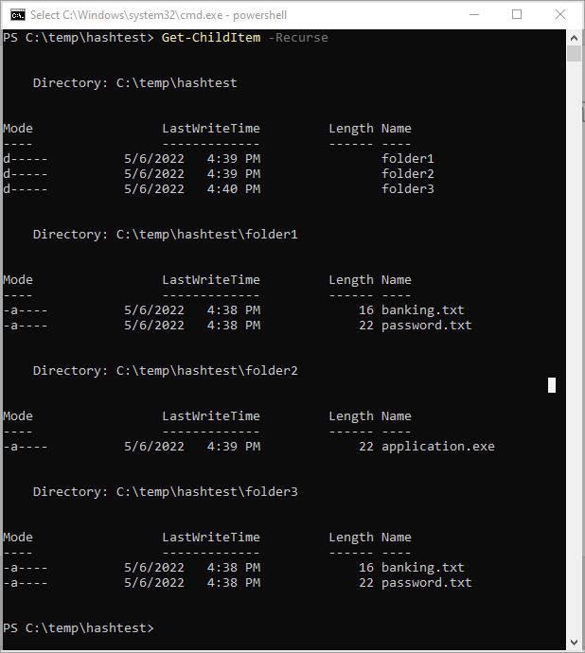
Share Remediation
The challenge
Determine questions
Identify data sources
Comparing& grouping
Folder list hashes
3 Directories
2 contain the same files
How can we identify those
Grouping on scale?

Slide 72
Share Remediation
The challenge
Determine questions
Identify data sources
Comparing& grouping
Folder list hashes
Directory List
Hashing

Slide 73
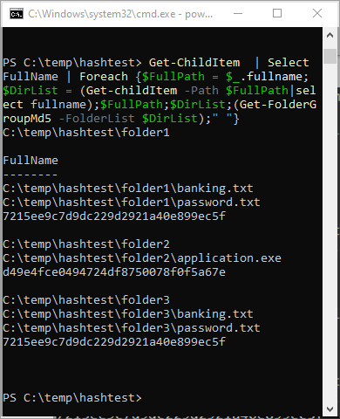
Share Remediation
# -------------------------------------------
# Function: Get-FolderGroupMd5
# -------------------------------------------
function Get-FolderGroupMd5{
param (
[string]$FolderList
)
$MyMd5Provider = [System.Security.Cryptography.MD5CryptoServiceProvider]::Create()
$enc = [system.Text.Encoding]::UTF8
$FolderListBytes = $enc.GetBytes($FolderList)
$MyMd5HashBytes = $MyMd5Provider.ComputeHash($FolderListBytes)
$MysStringBuilder = new-object System.Text.StringBuilder
$MyMd5HashBytes|
foreach {
$MyMd5HashByte = $_.ToString("x2").ToLower()
$MyMd5Hash = "$MyMd5Hash$MyMd5HashByte"
}
$MyMd5Hash
}
The challenge
Determine questions
Identify data sources
Comparing& grouping
Folder list hashes

Slide 74
Share Remediation
Collect
Required Data
The challenge
Determine questions
Identify data sources
Data collection
How will you
collect that data?
Active Directory ldap queries for computer and subnet information.
PowerShell can be run unprivileged or with administrative privileges via PowerShell Remoting
Get-ADComputer, Get-ADReplicationSubnet, Powerview
Shares RPC calls for share and file information.
Get-SMBShare, Get-SmbShareAccess, Get-ACL, Powerview
Notes:
https://docs.microsoft.com/en-us/powershell/module/activedirectory/get-adcomputer

Slide 75
Share Remediation
Collect
Required Data
The challenge
Determine questions
Identify data sources
Data collection
Quick Tips
Active Directory
Port Scanning
LDAP queries can provide a list of all domain computers
TCP 445 across known subnets
1 Include all domains
2 Verify domain user privileges
3 Ping & Port scan to understand potential connectivity issues
1 Make sure you have a complete
inventory of your subnets
2 Make sure you are not being
blocked by firewalls
Notes:
https://docs.microsoft.com/en-us/powershell/module/activedirectory/get-adcomputer

Slide 76
Share Remediation
Data
Analysis
The challenge
Determine questions
Identify data sources
Data collection
Data Analysis
Start grouping data to
answer questions!
What shares are high risk?
Who created the share?
When was it created?
Where was it created (systems & subnets)?
What is it associated with (apps, process, BU)?
How common is the share in the environment?

Slide 77
Share Remediation
Data
Analysis
The challenge
Determine questions
Identify data sources
Data collection
Data Analysis
Basic Techniques
Search for known high risk share names
Group/Count owners, names, subnets, files, acls
Timeline analysis to find patterns
Notes:
recommend
https://cyberwardog.blogspot.com/2017/12/ready-to-hunt-first-show-me-your-data.html

Slide 78
Share Remediation
Prioritizing
Triage
The challenge
Determine questions
Identify data sources
Data collection
Data Analysis
Data interpretation
Prioritize remediation
1
Filter for ACLs assigned
to inherited groups
2
Review high risk shares
3
Group shares by name
Reference owner, subnet computer object, & timeline
for additional context
Count, context, write read
4
Group shares by folder list
Count, context, write read
5
Cross Reference CMDB
Count, context, write read
Notes:
Finish this

Slide 79
Share Remediation
The challenge
Determine questions
Identify data sources
Data collection
Data Analysis
Data interpretation
Prioritize remediation
These techniques are not perfect
but they will help reduce effort during remediation
Notes:
Finish this

Slide 80
Into the Abyss: Evaluating Active Directory SMB Shares on Scale
Recommendations

Slide 81
Recommendations
Preventative
Measures
Preventative measures
Administrative Controls
Policies
Standards
Procedures
Change control
Least privilege
Attack Surface Reduction
Isolation
Network
Host-based

Slide 82
Recommendations
Detective
Measures
Preventative measures
Detective measures
Monitor Share Inventory
Monitor high value shares for changes
Perform your own discovery and analysis on a regular basis (ideally quarterly)
Monitor for Share Scanning
Port 445 scanning Netflow data
Authenticated scanning Event IDs: 540, 4624, 680,4625
Share scanning Event ID: 5140

Slide 83
Recommendations
Corrective
Measures
Preventative measures
Detective measures
Corrective measures
Track and Remediate Excessive Privileges
Make sure you have a system in place to track the share exposure and fixes over time.
Treat them like a vulnerability.
Assign a ticket to the owner of the system or application so the fixes can be tracked.

Slide 84
Into the Abyss: Evaluating Active Directory SMB Shares on Scale
PowerHuntShares
Automate High Risk Shares Identification

Slide 85
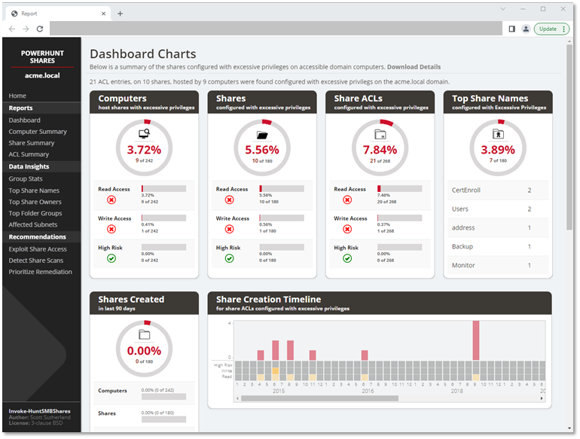


PowerHuntShares
Inventory Share Access
in Active Directory environments automatically Identify HIGH RISK Shares based on common names, files, and privileges
Prioritize Remediation using environment specific analytics
DOWNLOAD IT: https://github.com/NetSPI/PowerHuntShares
Open-Source Software

Slide 86
PowerHuntShares
Installation: Option 1
Installation
Download & Import
Import
https://github.com/NetSPI/PowerHuntShares/
Import-Module PowerHuntShares.psm1

Slide 87
PowerHuntShares
Installation: Option 2
Installation
Download & Load into Memory
[System.Net.ServicePointManager]::ServerCertificateValidationCallback = {$true}
[Net.ServicePointManager]::SecurityProtocol =[Net.SecurityProtocolType]::Tls12 IEX(New-Object System.Net.WebClient).DownloadString("https://raw.githubusercontent.com/NetSPI/PowerHuntShares/main/PowerHuntShares.psm1")

Slide 88
PowerHuntShares
Execution
Installation
Execution
Run from domain joined system
Run from a non-domain joined system
Invoke-HuntSMBShares -Threads 100 -OutputDirectory c:\temp\test
runas /netonly /user:domain\user PowerShell.exe
Invoke-HuntSMBShares -Threads 100 -RunSpaceTimeOut 10 -OutputDirectory c:\folder\ -DomainController 10.1.1.1 -Credential domain\user

Slide 89
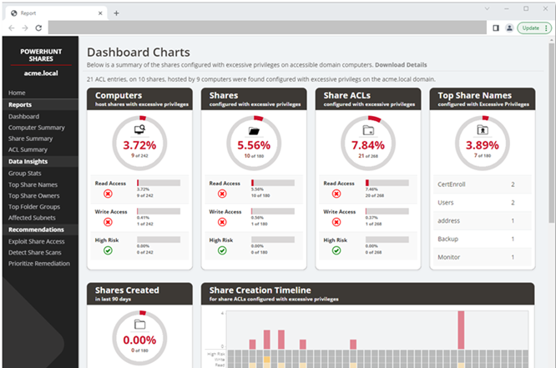
PowerHuntShares
Report
Installation
Execution
Reporting
HTML Report
review result summary and data insights to help drive remediation.

Slide 90
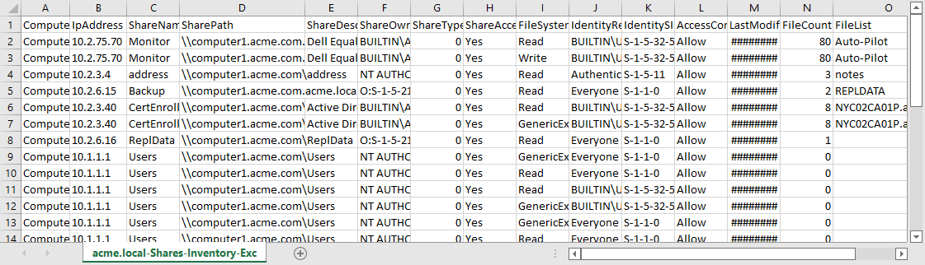
PowerHuntShares
Report
Installation
Execution
Reporting
HTML Report
review result summary and data insights to help drive remediation. CSV Output review potentially excessive share ACL entry details in the associated CSV files.

Slide 91
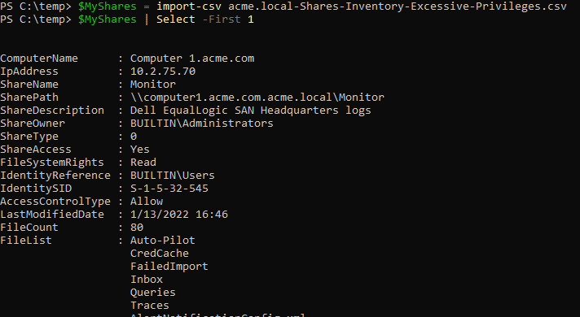
PowerHuntShares
Report
Installation
Execution
Reporting
HTML Report CSV Output
PowerShell

Slide 92
PowerHuntShares
Overview
Installation
Execution
Reporting
Demo Time!

Slide 93
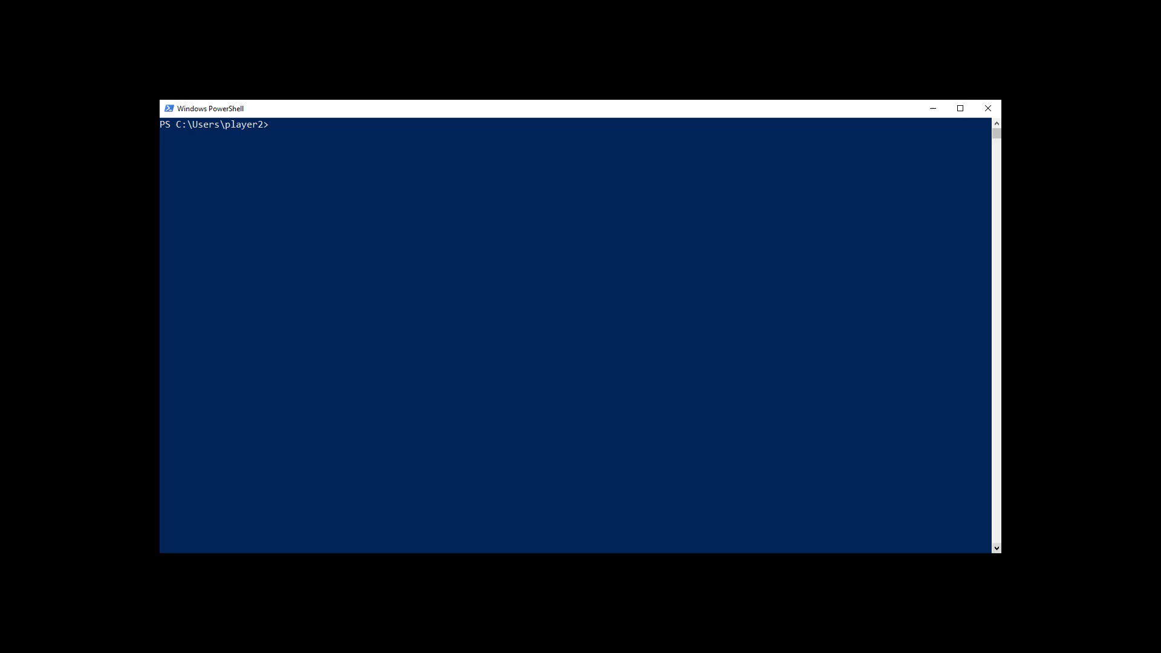
PowerHuntShares
Overview
Installation
Execution
Reporting
Demo Time!

Slide 94
Questions?
slides will be shared on twitter
@_nullbind
WWW.NETSPI.COM | SALES@NETSPI.COM

Slide 95
Always-on Pentesting
Platform Driven, Human Delivered.
WWW.NETSPI.COM | SALES@NETSPI.COM

Slide 96

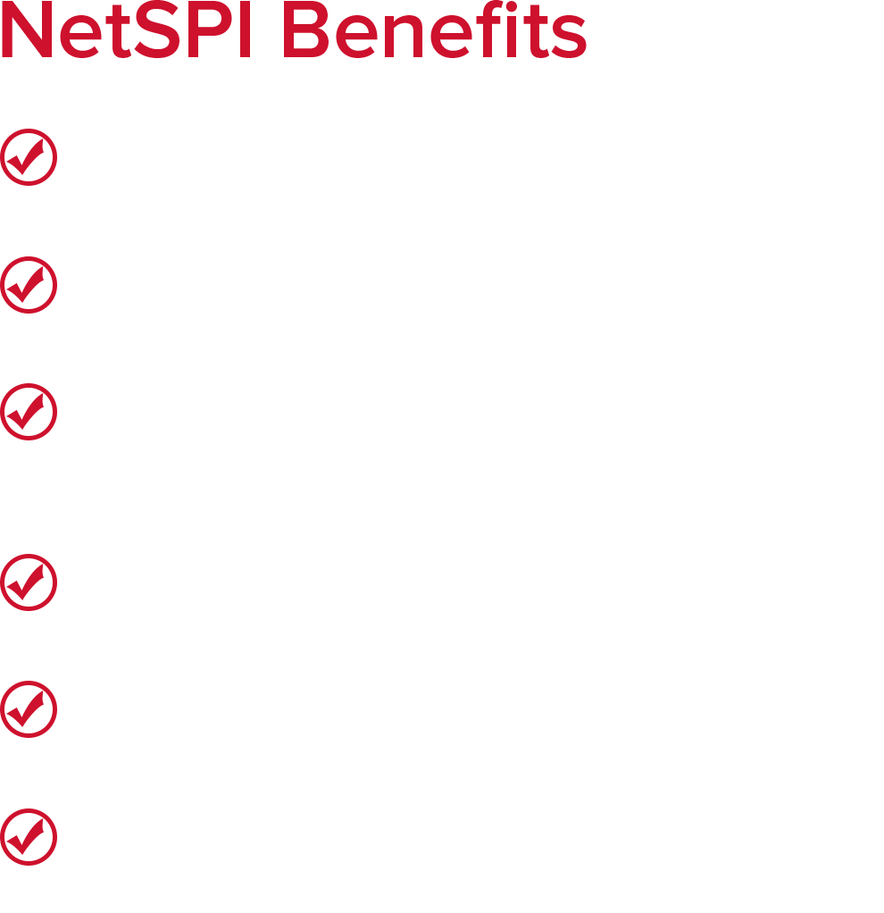
WE’RE GROWING!
JOIN US!
See current openings: www.netspi.com/careers
Send us your resume: jobs@netspi.com

